Slide 1
Geraldton Airport
Airside Landside Induction

Slide 2
Introduction to Geraldton Airport
This induction presentation is an overview of operations and safety management requirements at Geraldton Airport.
Before commencement of works, either Airside or Landside, you MUST read or review this induction presentation.
If you require further clarification, please contact Airport Staff prior to commencing works.

Slide 3
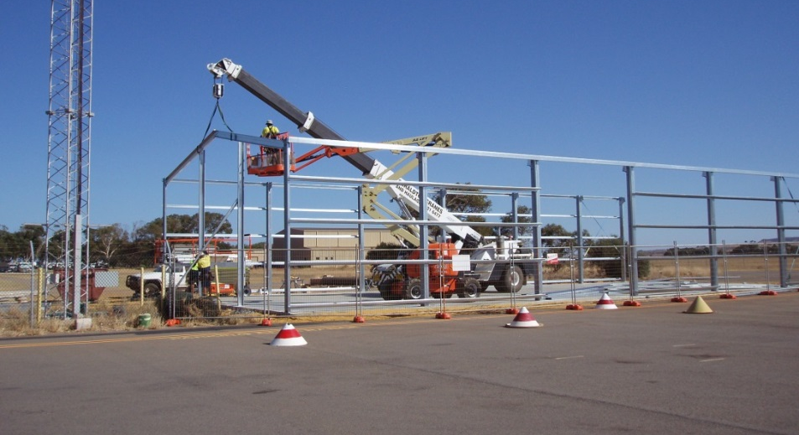
Workplace Policies
Geraldton Airport has policies on workplace health and safety, environment and risk management.
Geraldton Airport is committed to providing a safe and secure working environment.

Slide 4
Environmental Policy
Airport Management has a policy to ensure that everyone complies with applicable environmental laws and regulations.
The policy aims to:
Minimise risk to the environment;
Prevent pollution;
Minimise waste;
Manage scarce resources; and
Minimise risk to natural flora and fauna.

Slide 5
Taking Responsibility
Everyone who works at Geraldton Airport, including those working for Airport tenants and contractors, MUST take all reasonable care for the safety of themselves, their employees and others.

Slide 6
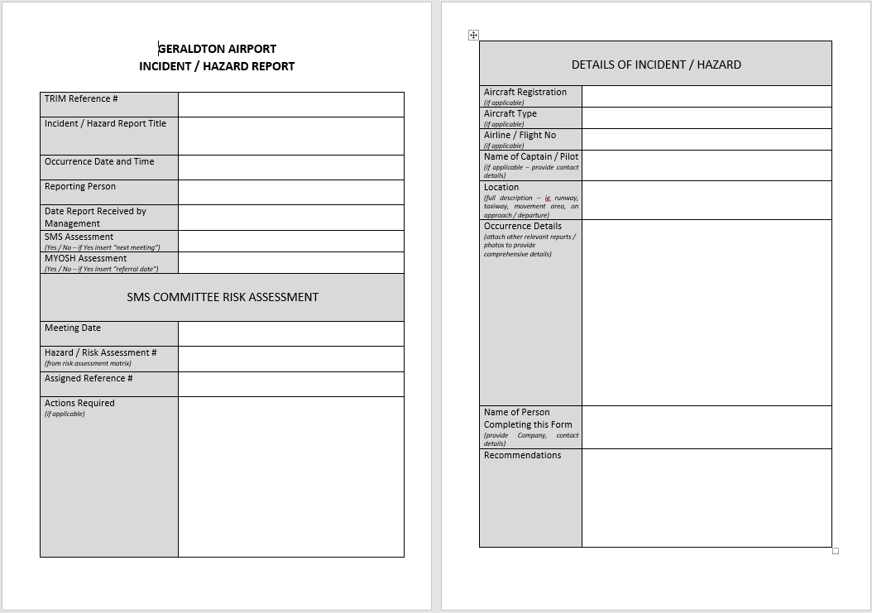
Areas of Responsibility
Geraldton Airport has a Safety Management Committee that meets regularly. The committee reviews all areas of Airport operations including safety.
All personnel who work within the Airport grounds has an obligation to report any hazards. A hazard report form should always be carried when carrying out works.

Slide 7
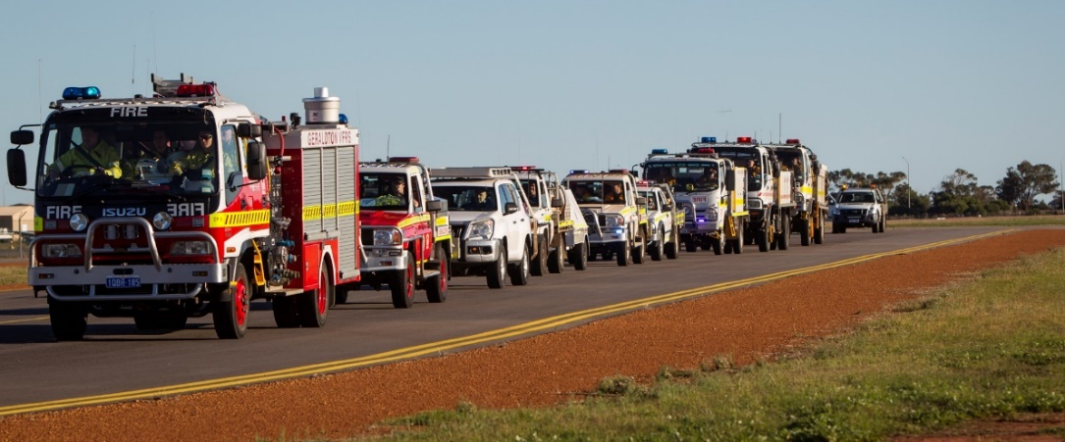
Emergencies
The Airport Emergency Plan (AEP) has been developed to cover the most likely emergencies, such as fires, aircraft crashes, incidents and spillage of hazardous substances (AV Gas, Diesel and any other propellant).
The AEP is exercised regularly and continuously improved.

Slide 8
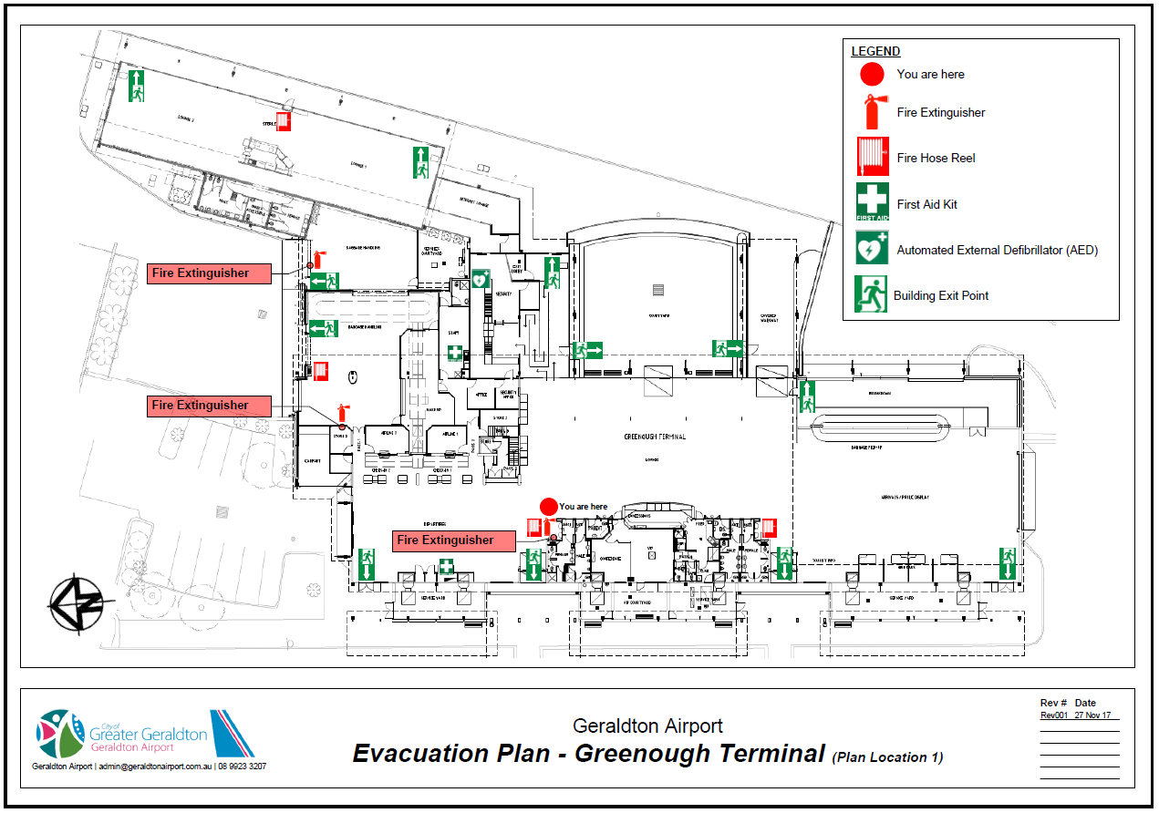
Fire / Emergency Evacuation
The Terminal building is fitted with a fire alarm system. Fire and Emergency Wardens will provide direction and occupants should exit as per the evacuation plan.

Slide 9
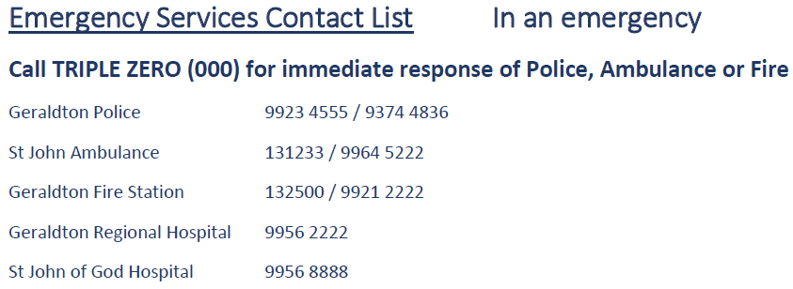
Evacuation Procedure
In case of an emergency, an audible warning siren will sound. In emergency situations, announcements are made by the fire wardens.
Evacuation diagrams are located on the walls within the Terminal.

Slide 10
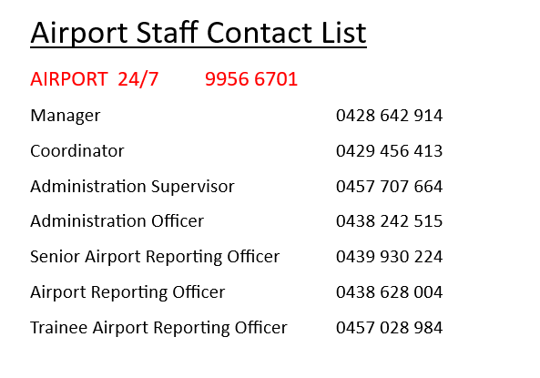

Slide 11
First Aid
For minor first aid assistance, first aid kits are provided in all Airport Management vehicles, works areas and offices.
There is a defibrillator located in the passenger screening area in the Main Terminal.
Always ring 000 in an emergency.

Slide 12
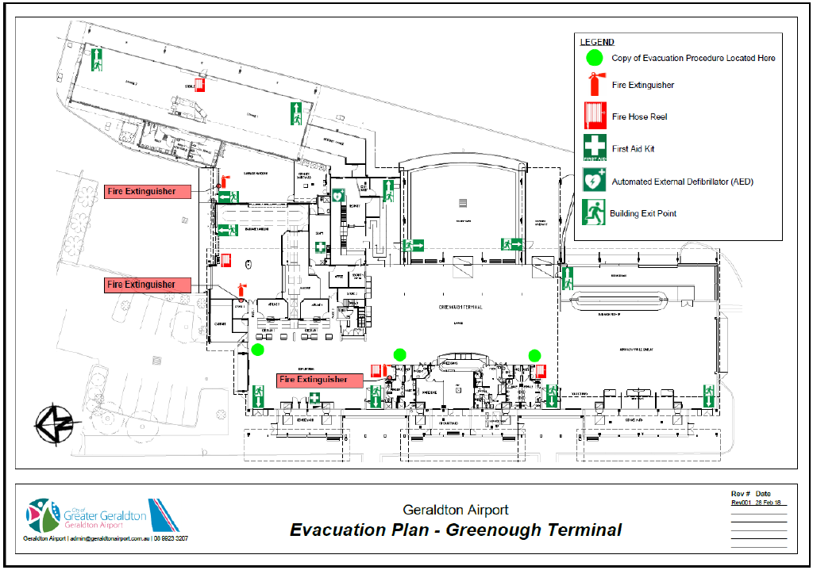

Slide 13
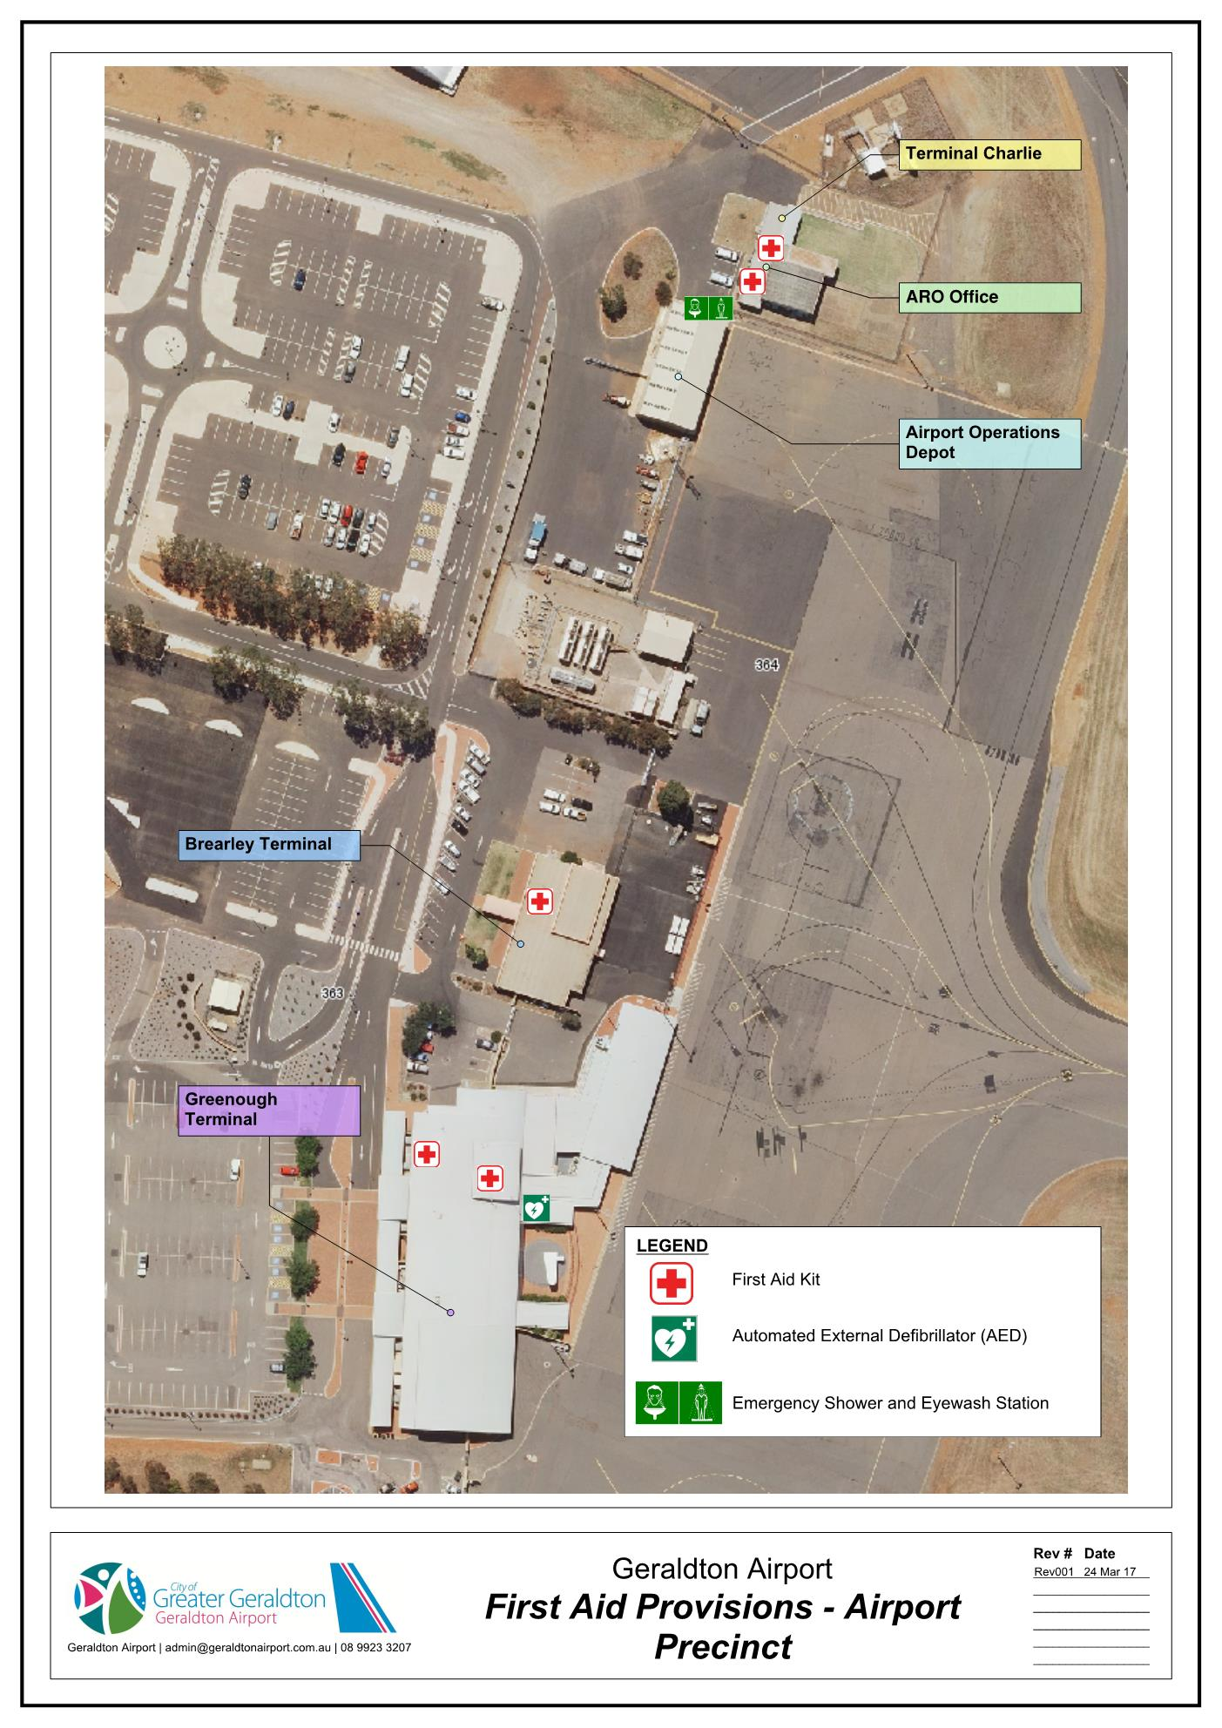
There is an Emergency Shower and Eyewash Station located at the Airport Operations Depot (adjacent to the ARO Office).

Slide 14
Incident Reporting
All incidents, including:
Accidents;
Fuel spills;
Injuries; and
Environmental damage

Slide 15
Taking Risks
It is never worth taking the risk, trying to cut corners, or going faster than the speed limit, or conditions allow.
Geraldton Airport is committed to conducting all operations in a safe, efficient and manageable environment.

Slide 16
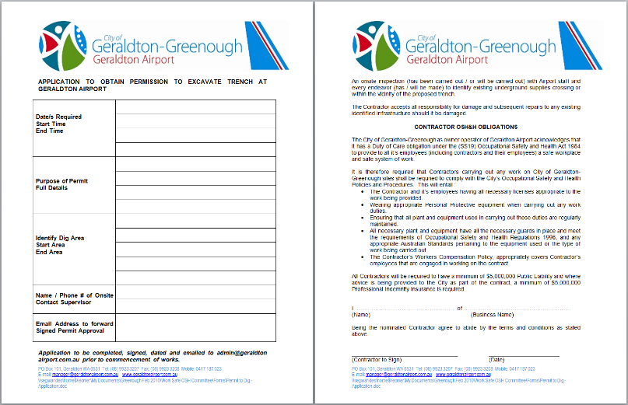
Works Permits
There are various major and minor permits that MUST be obtained from Airport Management prior to the commencement of works.
Some permits will require a site visit in advance before permit approval is granted. Please consult with Airport Management for appropriate permit applications.

Slide 17
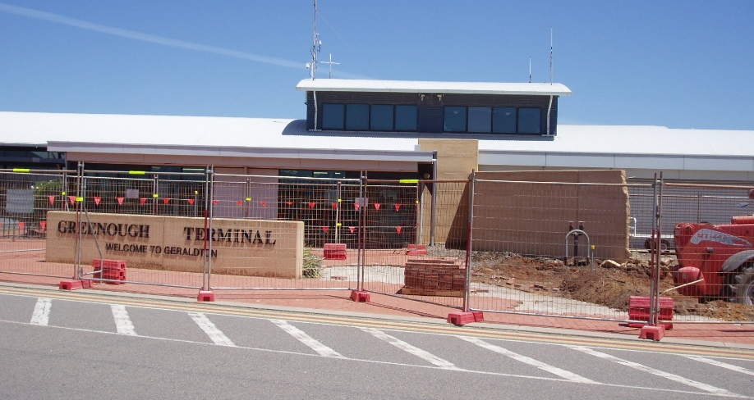
Digging & Trenching
You MUST contact Airport Management before you dig on Airport land.
All excavation work requires authorisation from Airport Management before any excavation work can begin.

Slide 18
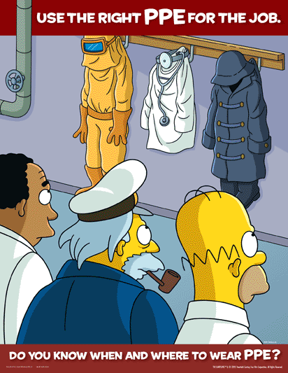
Protective Clothing (PPE)
Your clothing is very important in protecting you from everyday hazards in the workplace. Always ensure that you wear appropriate PPE at all times.
PPE can include:
Hat
Sunscreen
Hearing protection (plugs or ear muffs)
Sun glasses
Reflective vest or uniform
Steel capped boots
Gloves
PPE is very much job specific
and should be worn at all times.

Slide 19
Fatigue & Tiredness
If you are tired or fatigued it is harder to concentrate.
Be aware that you are more likely to make mistakes that could hurt yourself or others around you.

Slide 20
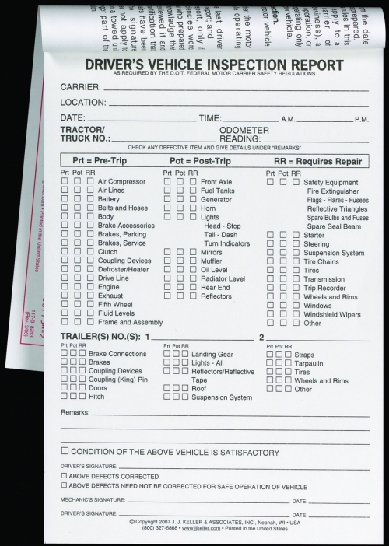
Plant & Equipment
You must be qualified, competent and appropriately licenced to operate powered equipment.
Your equipment must be maintained and in a serviceable condition.
Inspection of your equipment is advisable to be conducted at the beginning of your shift.
Attached is an example of a vehicle inspection checklist.

Slide 21
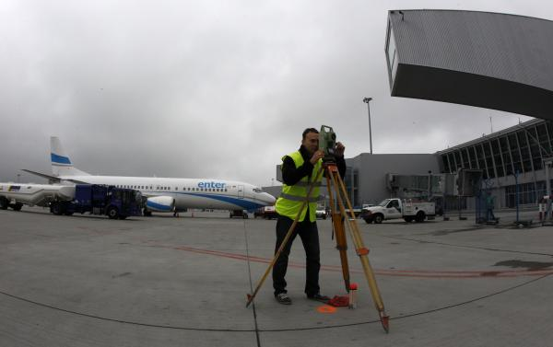
Works Safety Supervisor
When required, the Airport Management will assign a Works Safety Officer for any works carried out on the Airport land.
This applies mainly to Airside works but still does effect Landside works.

Slide 22
The Landside Module of the Geraldton Airport Induction is complete

Slide 23
Airside Module
This module is designed to provide an understanding of the Airside operations and hazards that exist at Geraldton Airport.
Only authorised personnel are permitted to access airside.

Slide 24
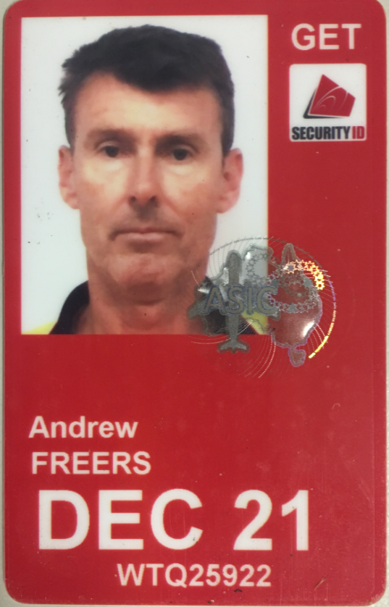
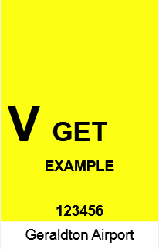
Identification Cards
Whilst Airside, you MUST prominently display either a valid:
Aviation Security Identification Card (ASIC)
OR
Visitor Identification Card (VIC)

Slide 25
Visitor Identification Card (VIC)
Anyone Airside with a VIC pass MUST be escorted and supervised by a valid ASIC holder.
Persons that require a VIC for a period exceeding 3 days must be issued with a VIC with a photo.
All VICs must be returned to the issuing body prior to leaving site.

Slide 26
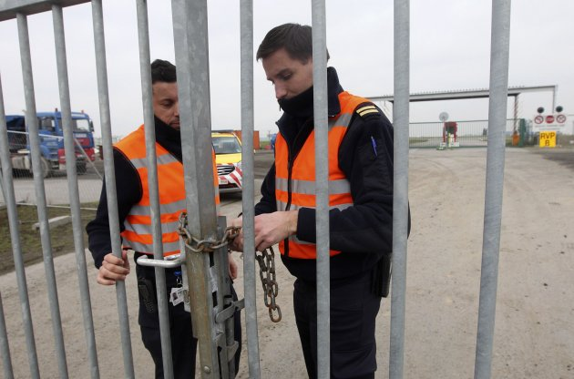
Security Gates
It is your responsibility as an ASIC and VIC pass holder to ensure that all security gates (personal and vehicle) are closed and secure after use.
Waiting for the gate to close before leaving the area after use is a mandatory requirement.

Slide 27
Movement Area Speed Limits
Drivers must adhere to the following speed limits:

Slide 28
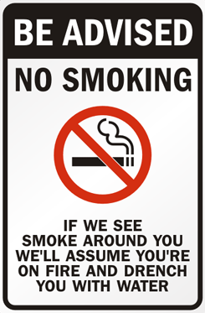
Smoking
SMOKING IS TOTALLY BANNED AIRSIDE
Geraldton Airport also prohibits smoking in Terminal buildings and within 5 metres of any entrance.

Slide 29
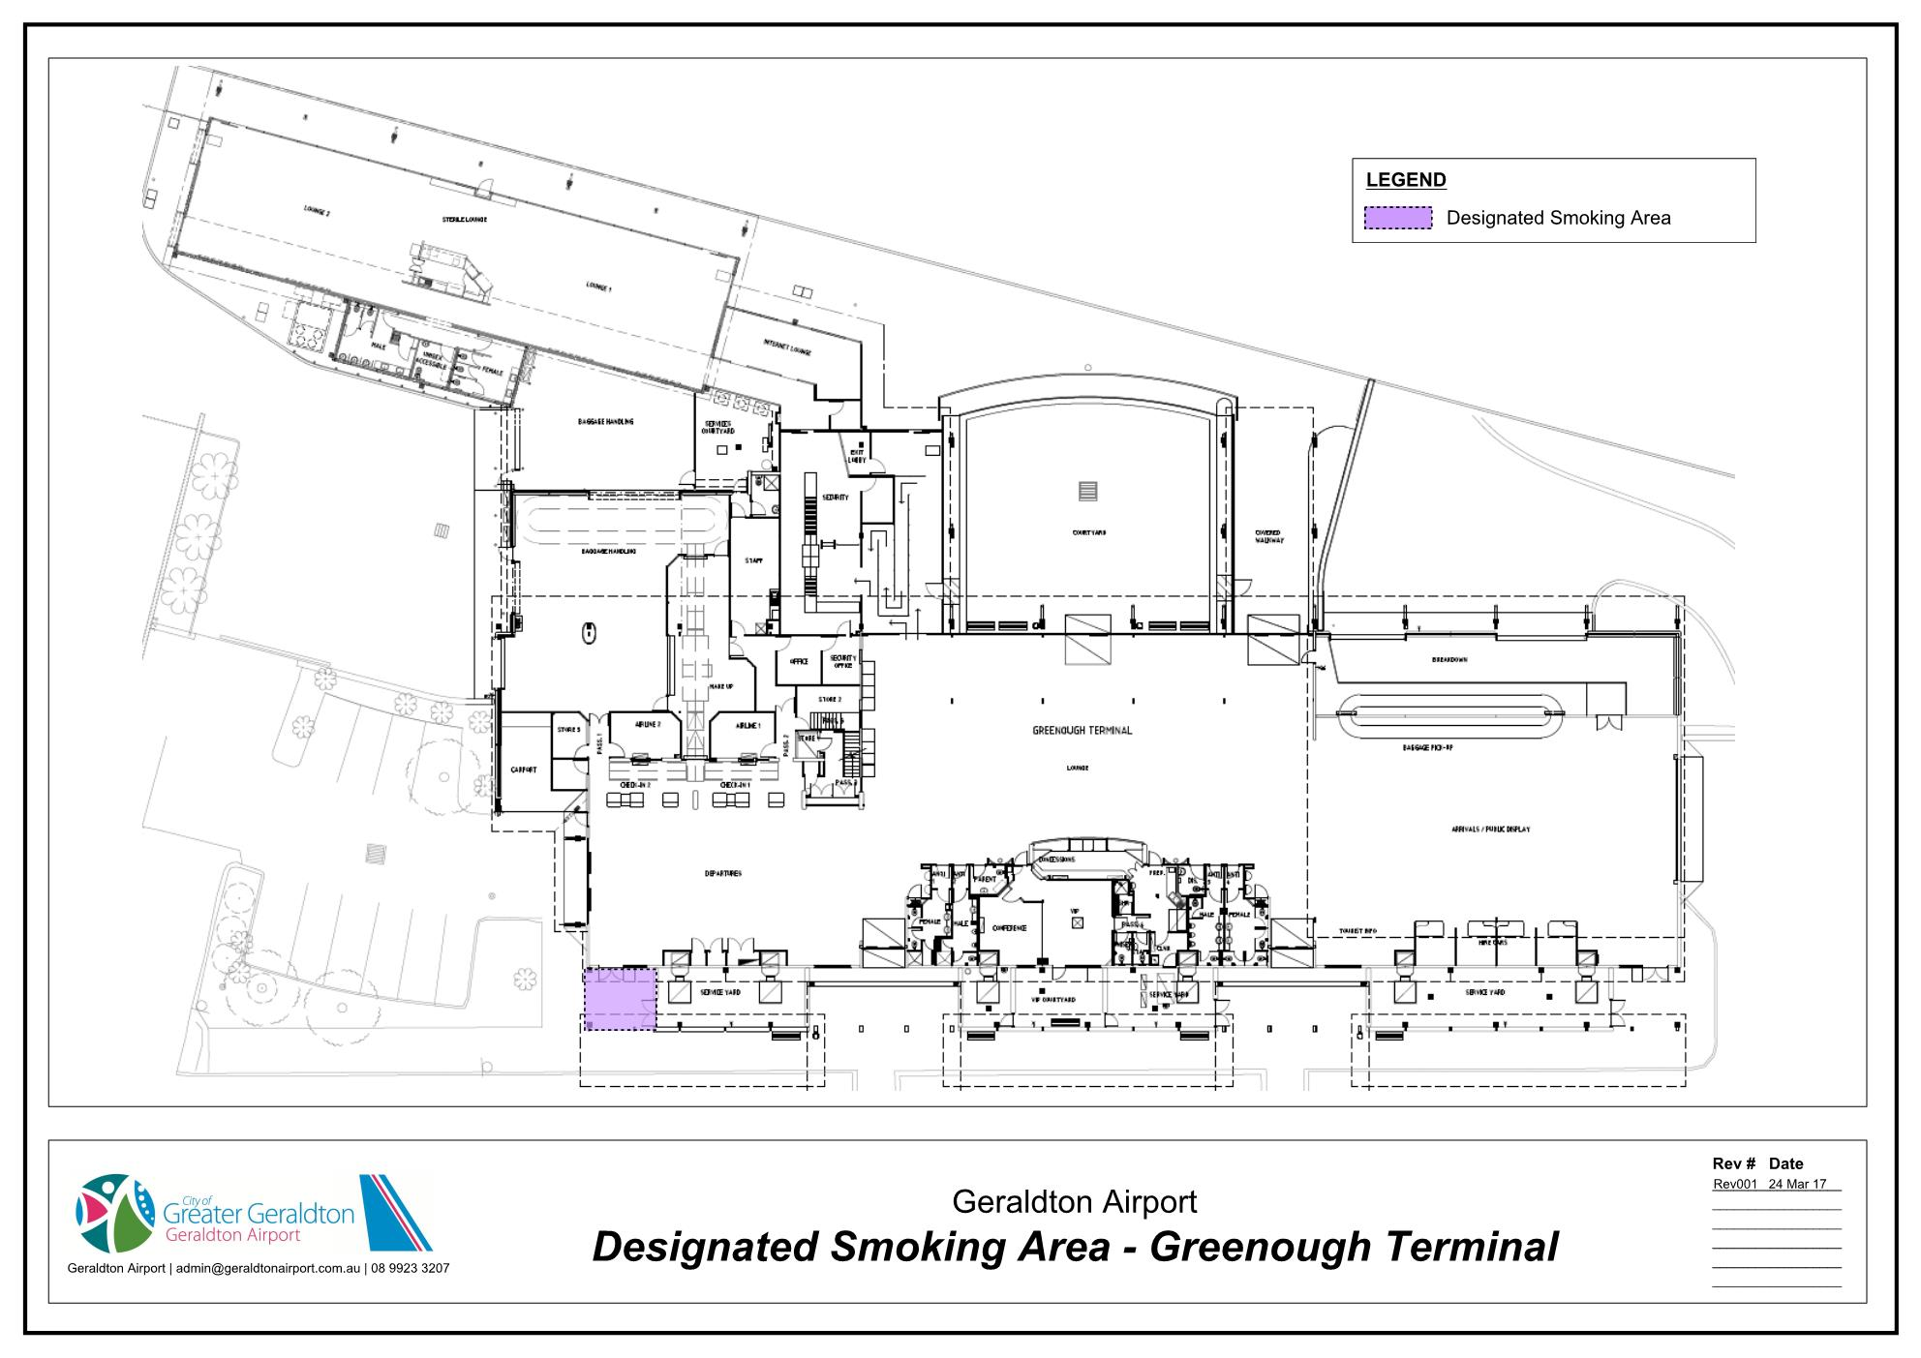

Slide 30
Drugs & Alcohol
Under CASA Regulations, Geraldton Airport has a Drug and Alcohol Management Plan otherwise known as DAMP.
To be fit to work or drive, you must not be affected by drugs (prescription or otherwise) or alcohol.
This is because the effects lead to poor judgment, reduced alertness and a false sense of confidence in a hazardous environment.

Slide 31
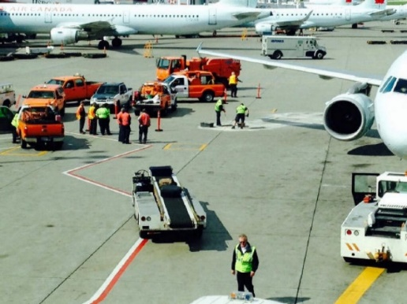
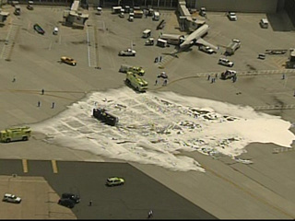
Spillage Containment
Any amount of aviation fuel must be cleaned up immediately (even wing fuel samples).
Any spills of hazardous substances (fuel, oil, diesel, hydraulic fluid) must be reported immediately to Airport Staff.

Slide 32
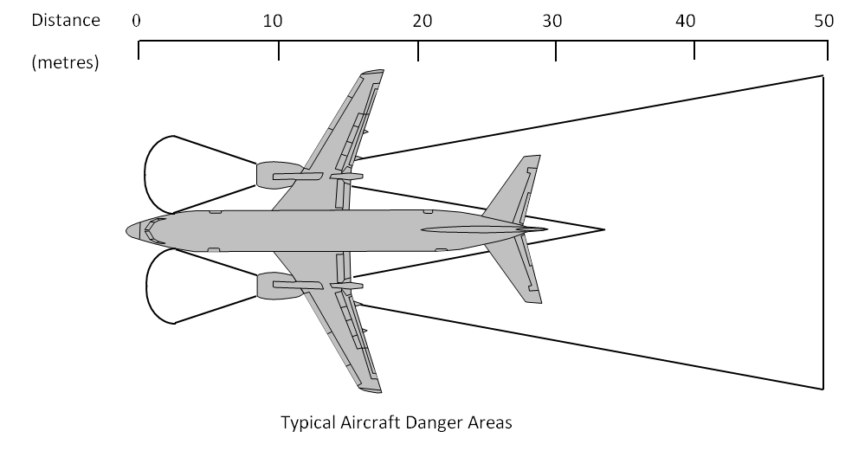
Aircraft Safety
Propellers and jets are unique to an Airport such as Geraldton. At no point should you approach an aircraft unless authorised to do so.
Propellers and Jet engines can appear as though they are not turning and pose serious risk of injury / death.
When the red rotating strobes or beacons are on, DO NOT APPROACH the aircraft.
Another risk associated with aircraft is PROP-WASH or JETBLAST. This is caused by the thrust from the engines or turbines. This phenomenon is known to overturn trucks and cars.

Slide 33
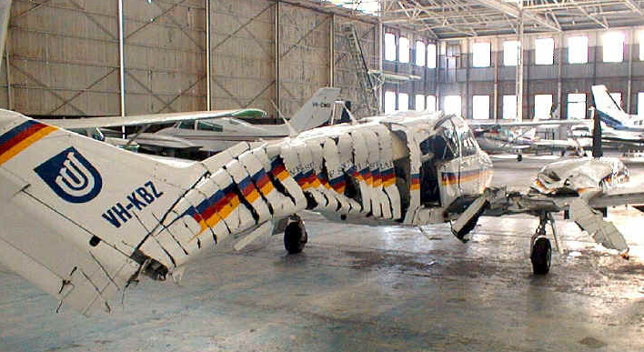
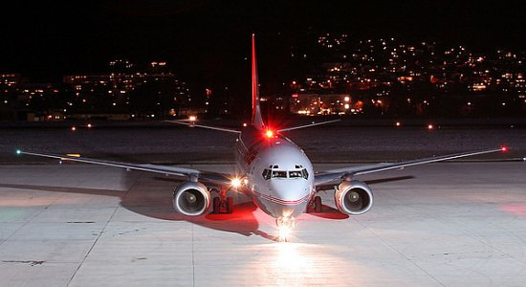
This is an example of what a propeller can do to an aircraft. Imagine if it was you!
Note the red rotating strobe/beacon on the top of the fuselage. This is the DO NOT APPROACH beacon. It can also be underneath and/or on the tip of the tail.

Slide 34
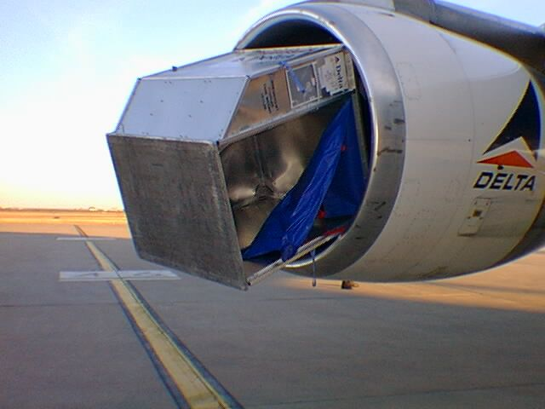
FOD – Foreign Object Debris
Modern aircraft engines act like powerful vacuum cleaners.
Any loose items within the vicinity of an aircraft pose a risk to become FOD. Items such as tools, drink cans, nuts and bolts or even sunglasses can be sucked into the aircraft engines causing expensive repairs as well as irreparable damage to the aircraft engine.
Whenever airside precautions MUST be taken to ensure your work area is clean and nothing can blow away or be sucked into a aircraft.

Slide 35
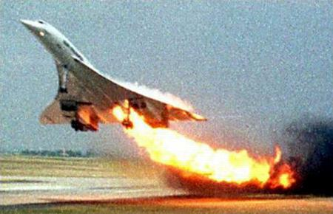
Effects of FOD
Flight 4590 was a charter destined for New York’s JFK airport on July 25th, 2000, carrying mostly German tourists headed to South America. As it neared takeoff speed, the Concorde struck a thin metal strip on the runway, causing one of its tires to burst. The strip had fallen from the underside of a Continental Airlines DC-10 that had departed minutes earlier, bound for Houston. Chunks of the burst tyre impacted the Concorde’s wing at tremendous velocity, resulting in a powerful shock wave within the wing’s fuel tank that ultimately punctured it. Gases from the engines then ignited leaking fuel, touching off a huge fire.
The crew wrestled the crippled jet into the air, but lost control moments later, slamming into a hotel. All 109 passengers and crew perished, as did four people on the ground.

Slide 36
Loose Loads
When carrying loose material, such as garbage or wastepaper, the load must be covered and thoroughly secure to ensure there is no risk of materials escaping and becoming FOD.

Slide 37
Height Limitations
There is limitations to how high mobile plant or fixed infrastructure can be on or near the Airport grounds, due to the Obstacle Limitation Surface (OLS).
To ensure aircraft and personal safety, approval is required from Airport Management before any crane or boom can be erected within or around the Airport.
Following is a copy of the OLS for Geraldton Airport.

Slide 38
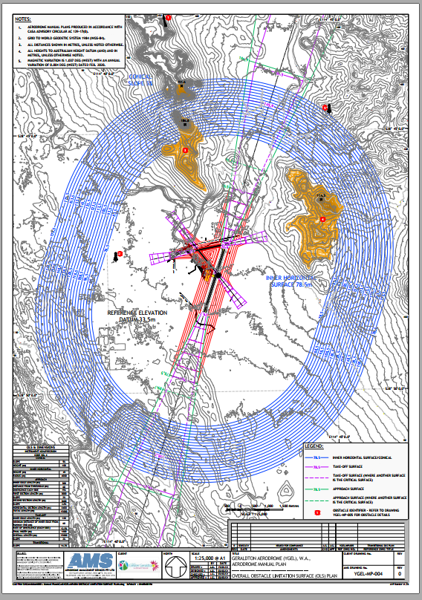
Geraldton Airport OLS

Slide 39
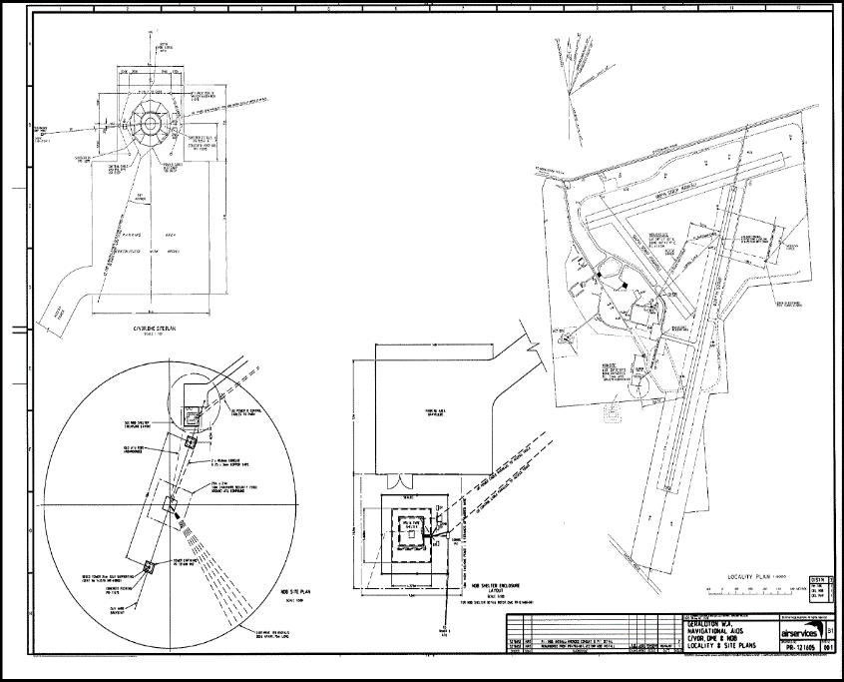
No-Go Safety Areas
There are some no-go area’s within the Geraldton Airport. At no point should you go near any of these areas. The main no-go areas are the VOR and the NDB but also include all runways unless escorted by an Airport Reporting Officer or Manager.

Slide 40
Congratulations!
You have completed the Geraldton Airport Site Induction

